Slide 1
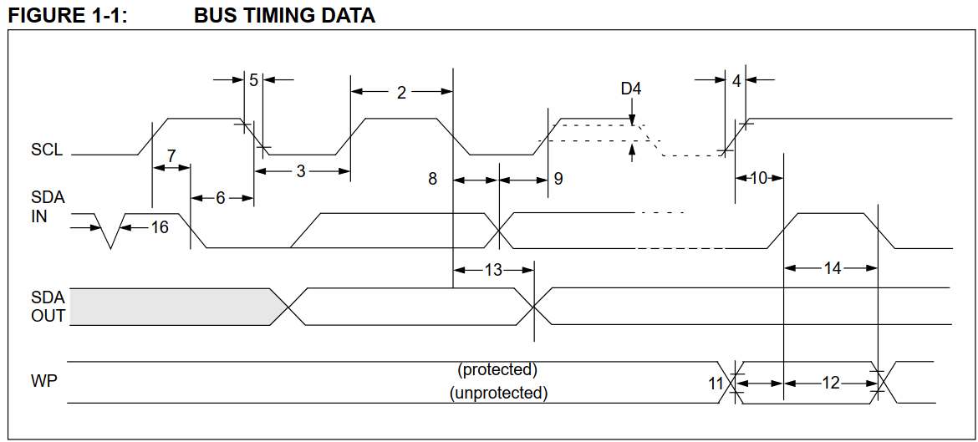

Slide 2
0 | 1 | 2 | 3 | 4 | 5 | 6
25 | 26 | 27 | 28 | 29 | 30 | 31 | 32 | 33
若位址起始點為0，使用page write可以寫0 ~ 31
若位址起始點為28，使用page write只能寫到31，32開始為下一個boundary

Slide 3
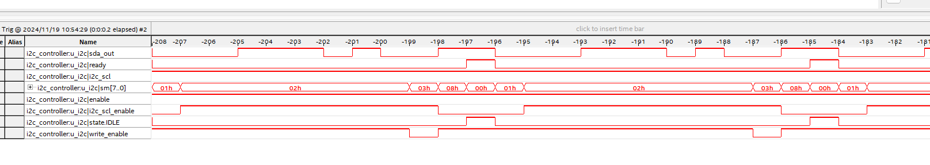
ACK or Read data才會拉低變Z

Slide 4
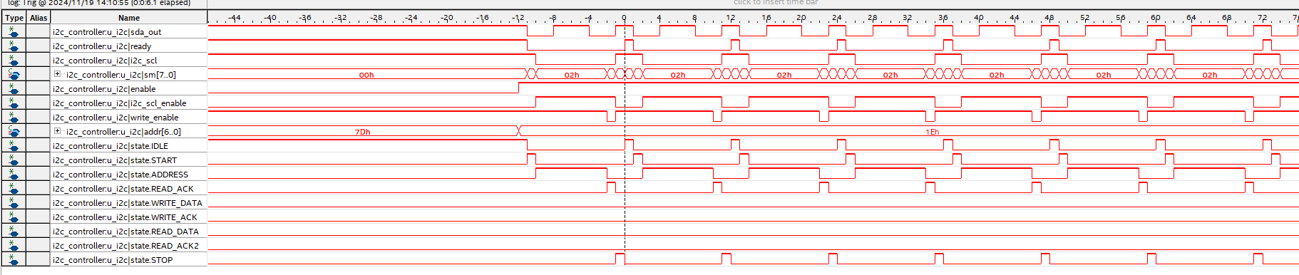
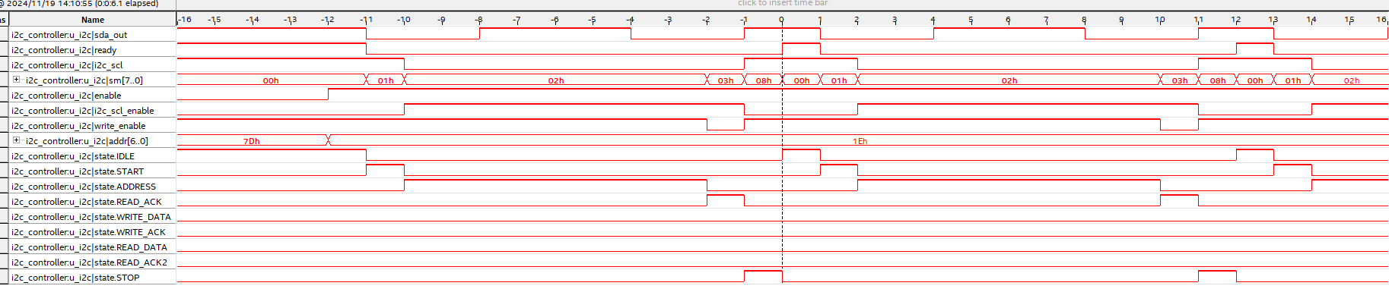
以ready做trigger

Slide 5
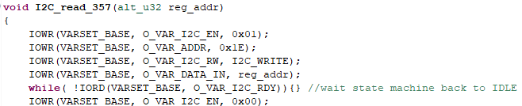
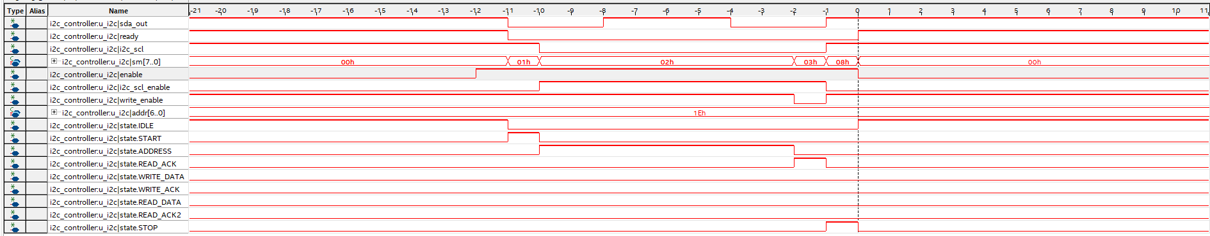
測試ready起來(回到IDLE)後關掉enable

Slide 6
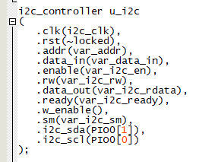
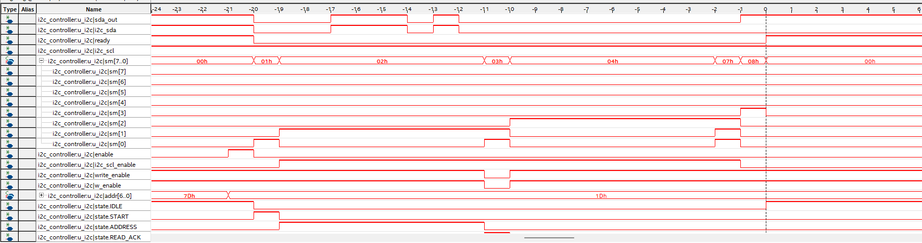
修改I2C接口PIO

Slide 7
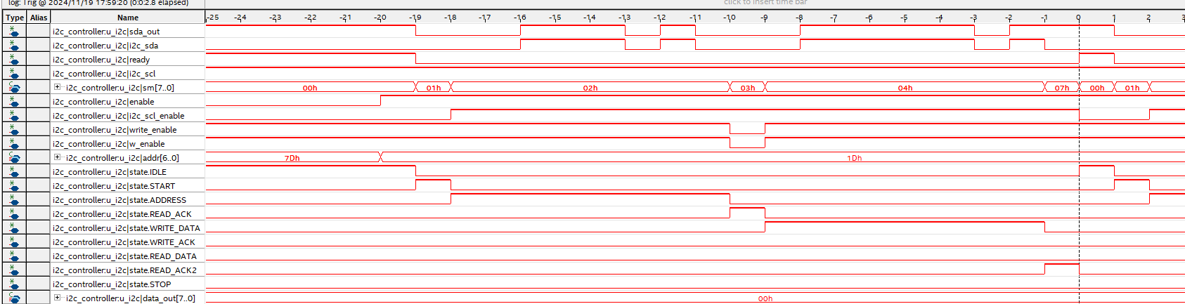

Slide 8
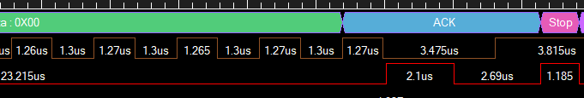
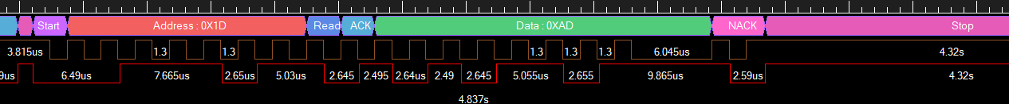
使用Arduino 測試:

Slide 9
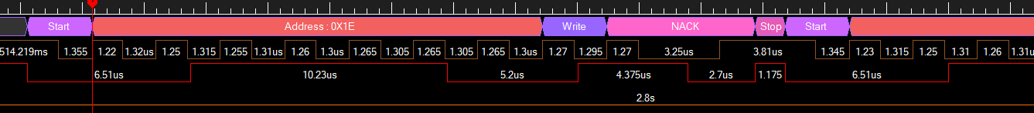
Device address 輸入錯誤case

Slide 10
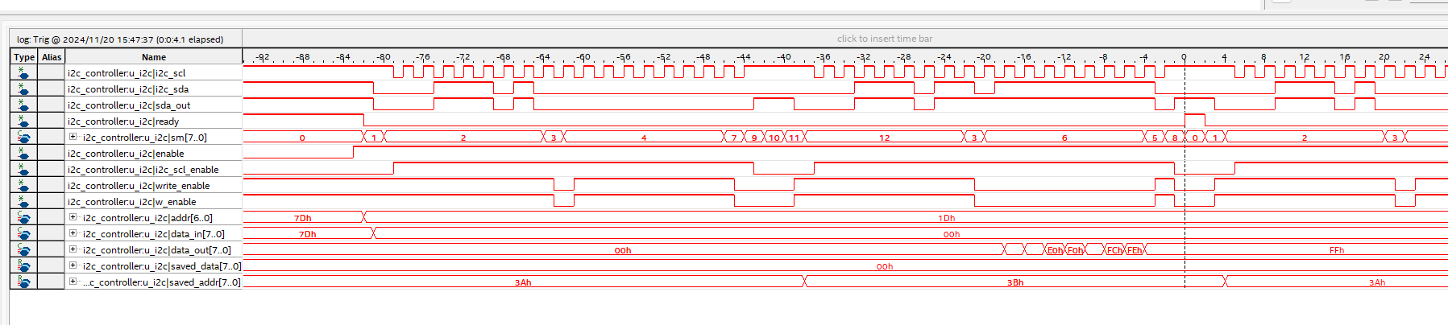

Slide 11
使用FPGA 測試, READ_ACK2_B裡 act_counter = 2:

Slide 12
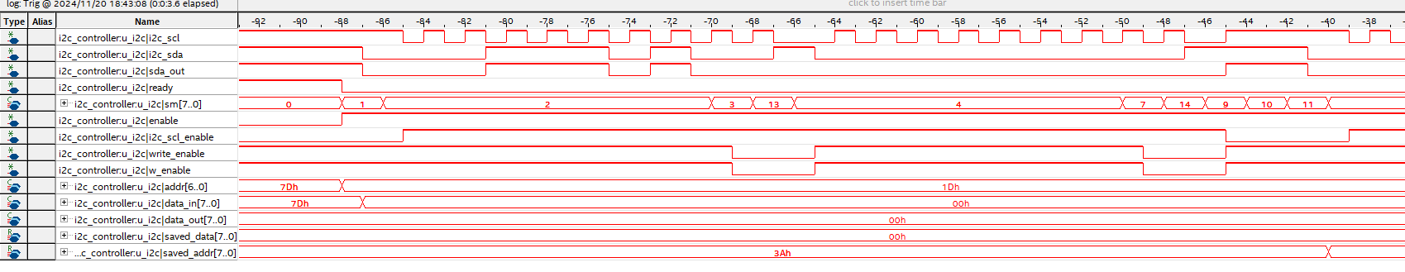
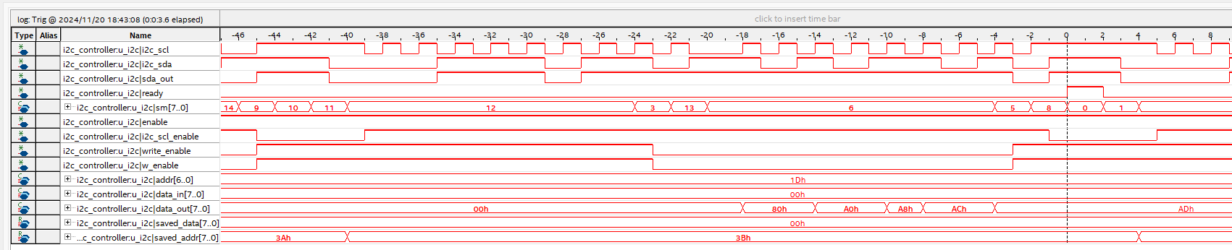
read ack完後要先將SCL拉低，此時355 sda會拉高，結果才會正確
要有start

Slide 13
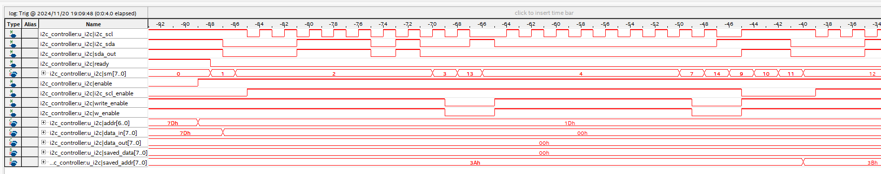
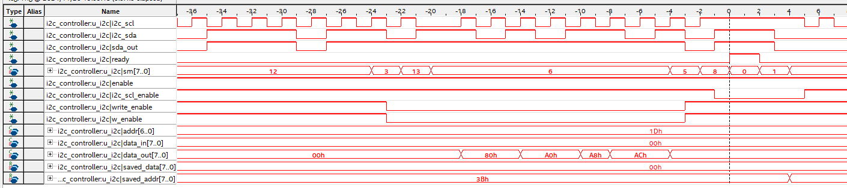

Slide 14
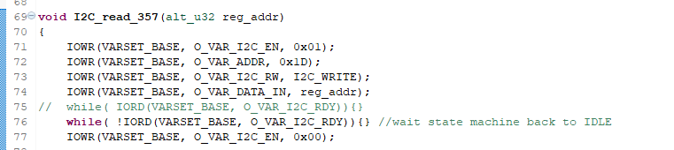

Slide 16
IDLE: 進入START state, I2C_SCL = 1, I2C_SDA = 未定
state | negedge | posedge
STOP | I2C_SCL = 1 write_enable <=1; sda_out <= 1; | 敲入IDLE | I2C_SDA = 1
IDLE | I2C_SCL = 1 | 敲入START | I2C_SDA 未定
START | I2C_SCL = 1 write_enable <=1; sda_out <= 0; | 敲入ADDRESS | I2C_SDA = 0
ADDRESS | I2C_SCL = I2C_CLK | 敲入READ_ACK | I2C_SDA = address + r/w
READ_ACK | I2C_SCL = I2C_CLK write_enable <=0(sda=z); | 讀取I2C_SDA值 敲入READ_ACK_B(若ack) 敲入STOP(若nack) | I2C_SDA = 0 (若ack) I2C_SDA = 1 (若nack)
READ_ACK_B | I2C_SCL = 0 write_enable <=0(sda=z); | 敲入WRITE_DATA or READ_DATA | I2C_SDA = device 回應
355實測READ_ACK完後要讓SCL維持L一個週期
STOP -> IDLE -> START: 一定會產生start(若在IDLE有enable的話，IDLE的存在為了判斷enable還在不在)
STOP -> START: 一定會產生start
IDLE -> START: 不一定會產生start(若IDLE前SDA為0的話)
STOP會在negative edge將SDA拉高，因此在敲入STOP時若SCL為高且SDA為低，才會產生STOP
ACK時SCL為H且SDA為L，再接上STOP則會產生STOP

Slide 17
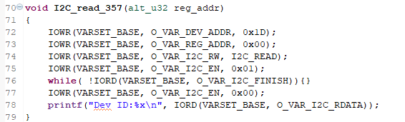
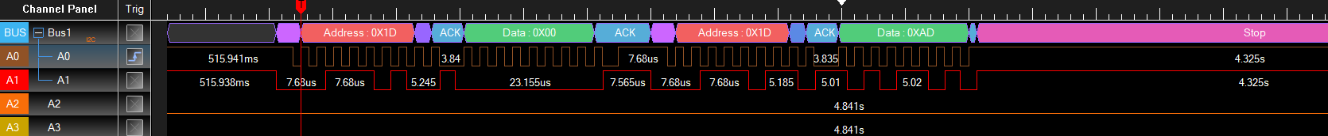
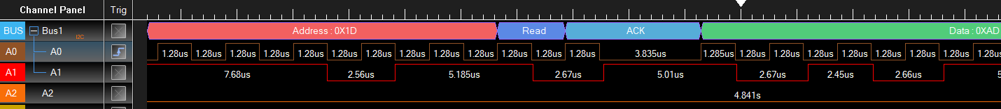

Slide 18
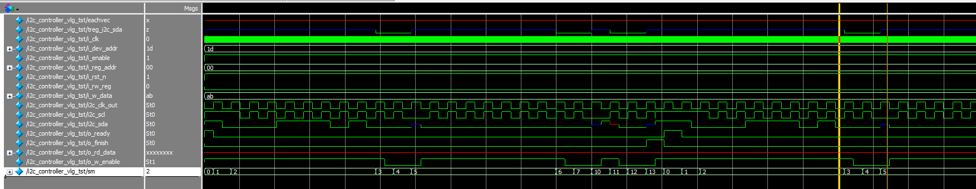
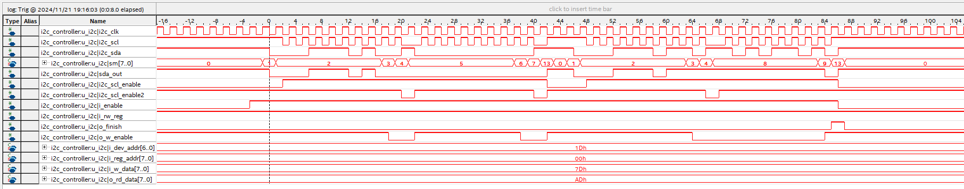

Slide 19
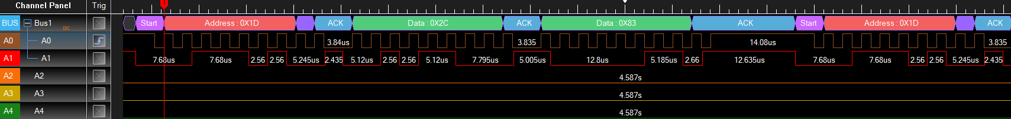
write完沒有stop停在ack，直接到read了

Slide 20
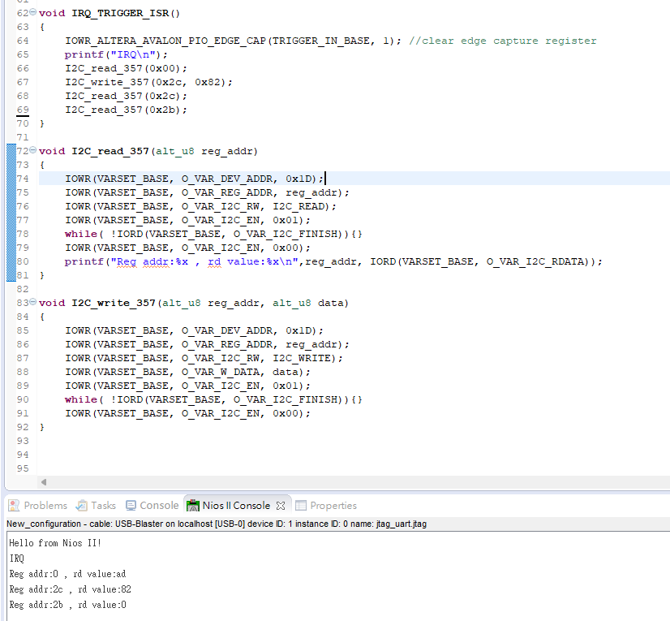

Slide 21
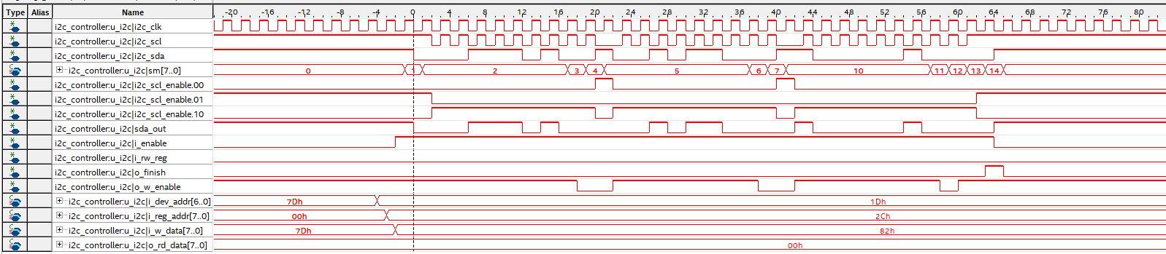
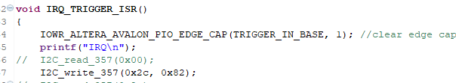
11/22
write

Slide 22
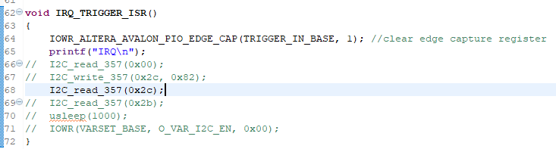



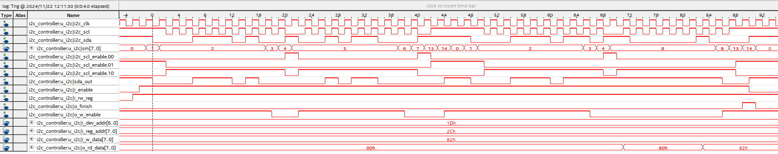
read

Slide 23
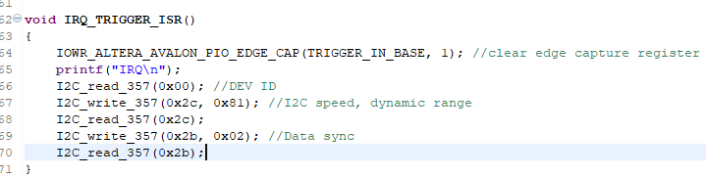
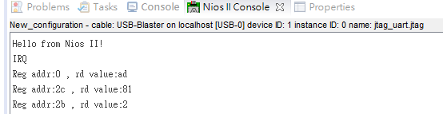

Slide 24
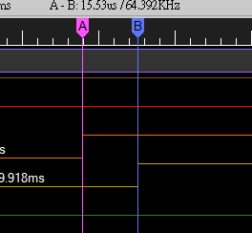
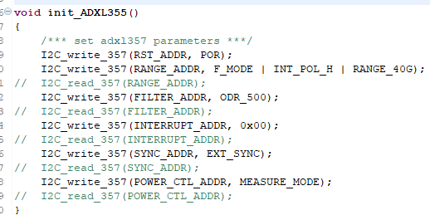
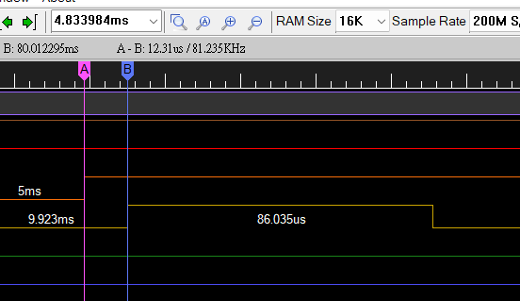
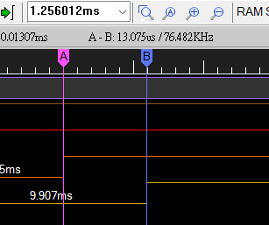
給SYNC，不需讀取I2C即可收到DRDY@INT2
FILTER_ADDR 可加可不加

Slide 25
加入DRDY:
I2C module內新增input切換op mode: CPU mode, FPGA mode。
CPU mode:
外部SYNC來後送到CPU觸發ISR，ISR內對I2C module寫EN啟動狀態機 -> 因為SYNC與drdy間只有不到2us延遲，而一個clock period就快超過了
無外部SYNC時由CPU直接對EN寫值，用在一開始做configuration時(main())
FPGA mode: 將I2C module之EN 接口寫成 (r_drdy | var_EN)，r_drdy為i_drdy之打一拍並使用FPGA clock敲入，當r_drdy為H時啟動狀態機，FPGA mode之狀態機路徑需與CPU mode不同。
11/24 新增ctrl register取代EN輸入，新增單獨一個i_drdy，在各模組裡面做r_drdy | ctrl[x] (EN)

Slide 26
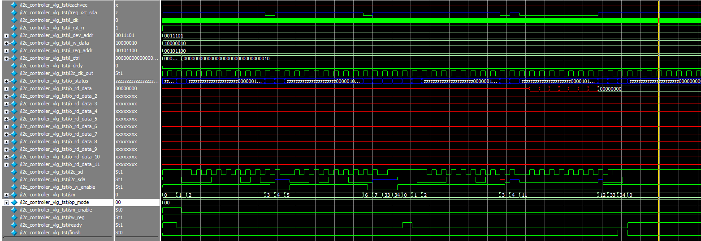
12/2/2024:
OP_mode = CPU read 1 byte
start
stop
finish

Slide 27
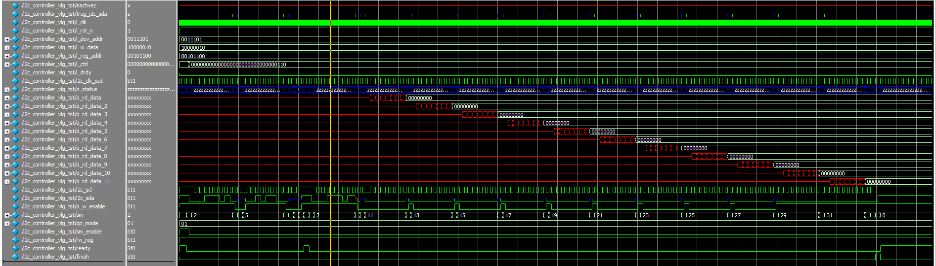
OP_mode = CPU read 11 byte
finish

Slide 28
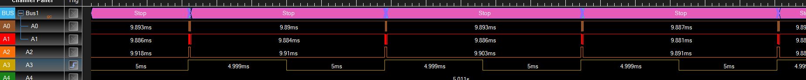
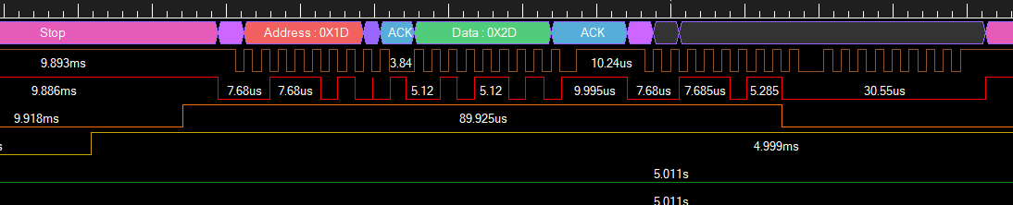
OP_mode = CPU read 1 byte
drdy ~ 90 us

Slide 29
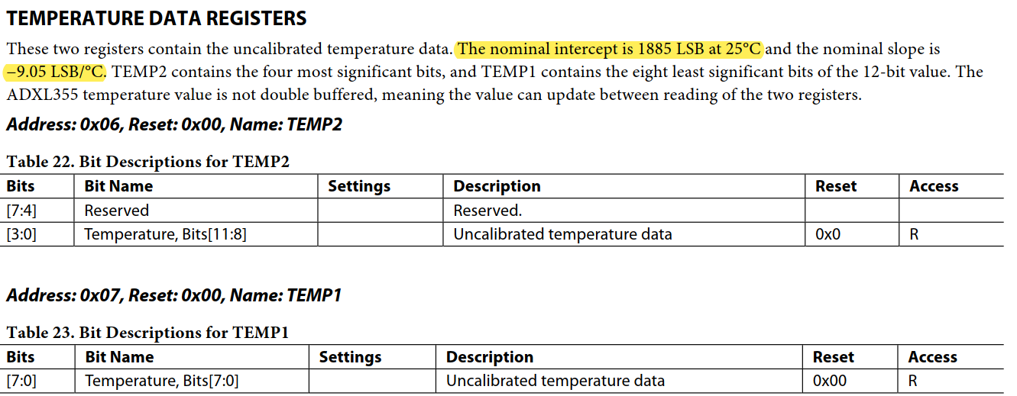
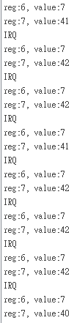

12/3/2024:
使用CPU1 mode讀溫度測試:
hex(740) = 1856, T = 28.20
hex(741) = 1857, T = 28.09
hex(742) = 1858, T = 27.98
hex(73d) = 1853, T = 28.54
LSB = 1885 + m*(T-25)
T = (LSB – 1885)/m+25

Slide 30
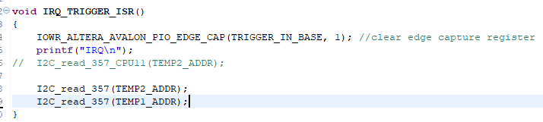
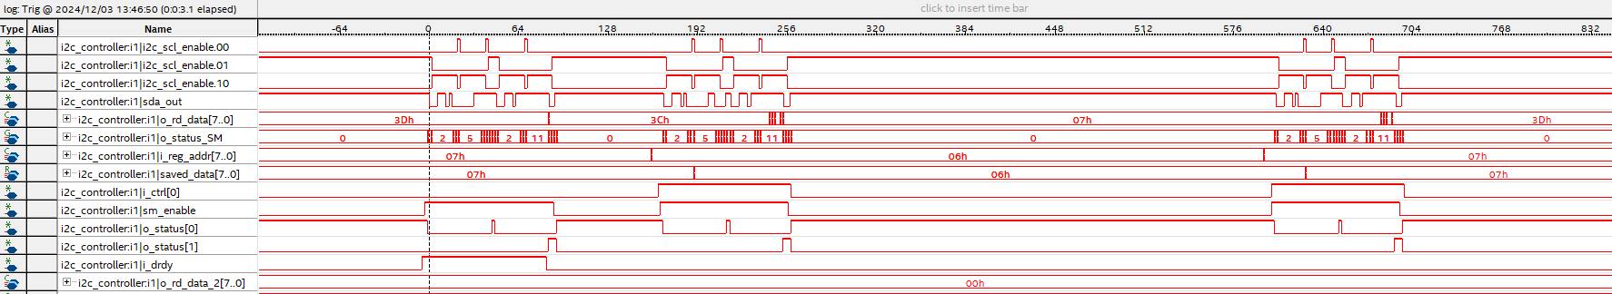
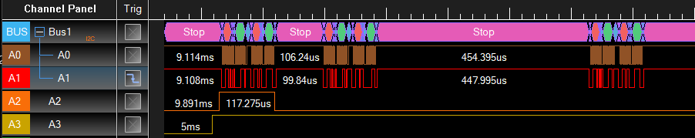
使用CPU1 mode讀溫度:
i_en
finish
ext sync造成的drdy

Slide 31


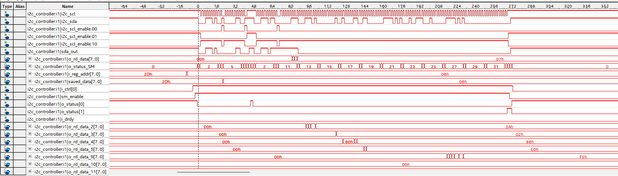
使用CPU11 mode:
temp2 | temp1 | XDATA3 | XDATA2 | XDATA1 | YDATA3 | YDATA2 | YDATA1 | ZDATA3 | ZDATA2 | ZDATA1
7 | 29 | 0 | 27 | 50 | 1 | 3c | 0 | f | 0 | 0
1833 |  | 629 |  |  | 5056 |  |  | 61440
30.74 |  | 0.0098 |  |  | 0.079 |  |  | 0.96
7 | 32 | 0 | 3f | 90 | 0 | 1 | a0 | f2 | 0 | 0
1842 |  | 1017 |  |  | 26 |  |  | -57344
29.75 |  | 0.0159 |  |  | 0.0004 |  |  | -0.5896

Slide 32
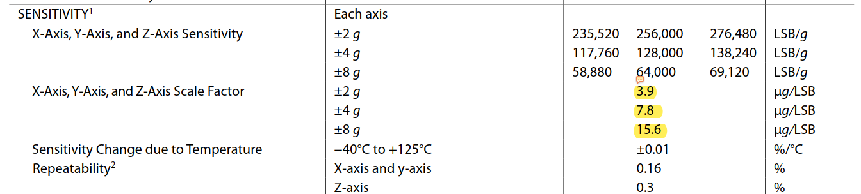

Slide 33
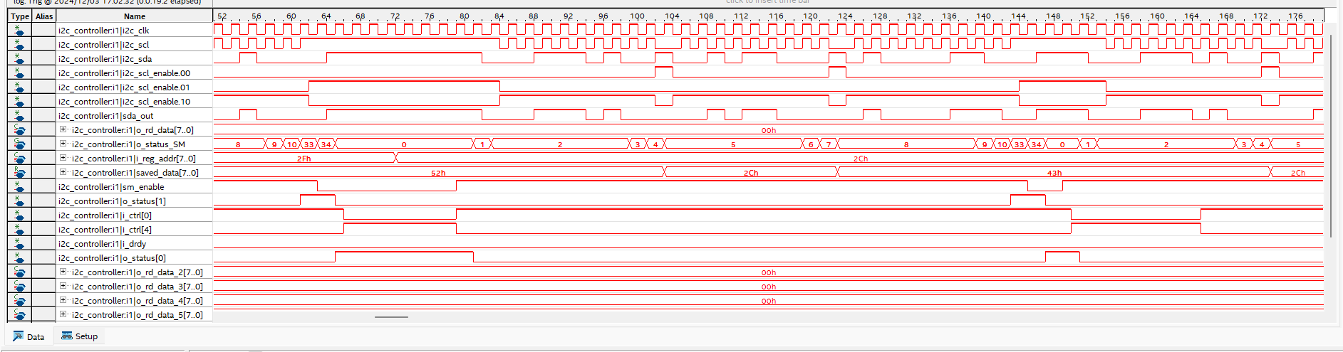

Slide 34
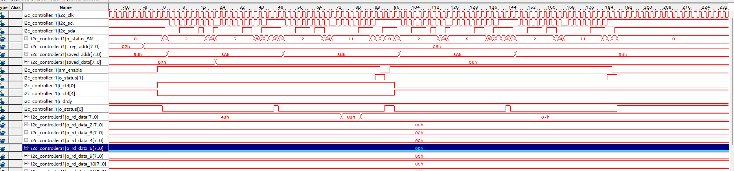

Slide 35
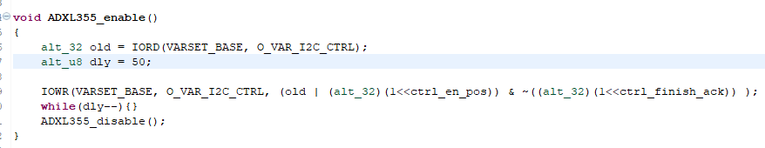
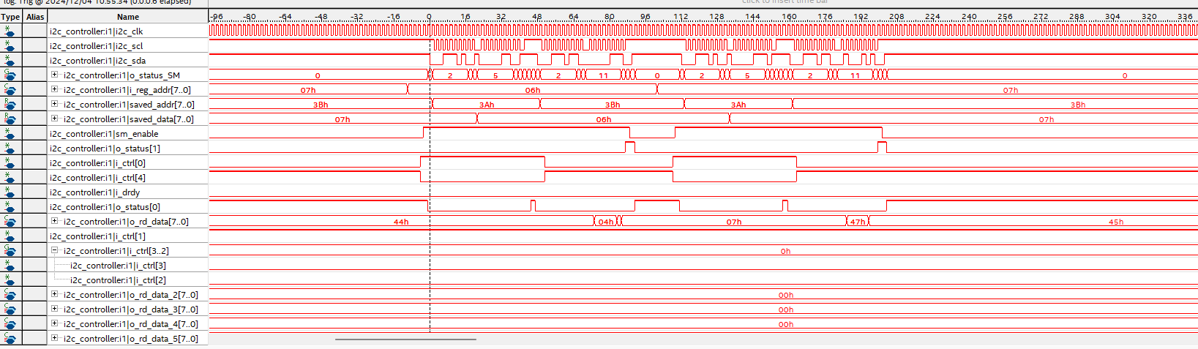
12/4/2024:

Slide 36


讀溫度時間~260us

Slide 37



讀全部時間~350us

Slide 38


Slide 39

讀HW11

Slide 40


SYNC to DRDY: 13.57 us
DRDY to SDA falling: 6.25 us

Slide 41



200 Hz

Slide 42



1000 Hz

Slide 43

780 clk = 780 * 1.28us = 998.4 us ~ 1ms

Slide 44

clk: 390 K

